Slide 1

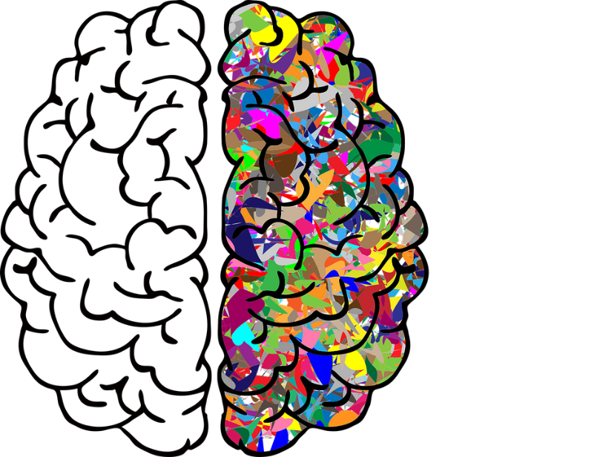
Group No -18
BE Final Year Project
AI&DS
ZCOER
A Low-Cost AI-Empowered Stethoscope and a Lightweight Model for Detecting Cardiac and Respiratory Diseases from Lung and Heart Auscultation Sounds
PROJECT MEMBERS :- 1. TEJAS SAWANT
2. SHUBHAM LINGAYAT
3. PRATHMESH LOHAR
4. SUJAL KHOPADE
GUIDED BY :- PROF. S. S. VYAVAHARE

Slide 2


Agenda
1.Overview
2.Problem Statement
3.Features
4.Literature Survey
5.​Requirement Analysis :-
Software and Hardware
6.Proposed Model (Block Diagram)
7.Advantages

Slide 3

1.Overview
According to a report of the WHO, cardiac and respiratory diseases are the primary causes of health problems, leading to the death of millions of people annually worldwide.
If we can automate anomalous heart and lung sound diagnosis, we can improve the early detection of disease
There is a need to develop a lightweight yet powerful model for lung and heart sound diagnosis that is deployable in an embedded low-cost device and is valuable in remote areas or developing countries where Internet access may not be available.
Some common Cardiovascular diseases (CVDs) are conditions that affect the heart and blood vessels. It includes Heart attack, Stroke, Heart failure, Arrhythmia, Heart valve complications, etc.
The most common respiratory (lung) diseases include asthma, chronic obstructive pulmonary disease (COPD), bronchiectasis, bronchitis, pulmonary fibrosis, sarcoidosis, lung cancer, pneumonia, pulmonary edema, and influenza (“the flu”).

Slide 4

2.Problem Statement
The goal of this project is to develop a low-cost AI-empowered stethoscope integrated with a lightweight machine learning model for the accurate and early detection of cardiac and respiratory diseases from lung and heart auscultation sounds.
Many regions lack access to well-trained medical professionals and diagnostic equipment, making early disease detection difficult.
High-quality stethoscopes with AI capabilities are expensive, limiting their adoption in low-resource environments.
Interpretation of auscultation sounds is highly dependent on the skill and experience of the healthcare provider.

Slide 5

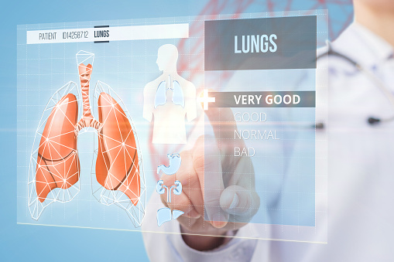
3.Features
Heart and Lung Sounds mode switch
Software Filter:
Infinite Impulse Response(IIR)
Finite Impulse Response(FIR)
Algorithm:
Heart Sound and Lung Sound separation algorithms
PC-Host Analysis
Fast Furious Transform(FFT) amplitude spectrum and Mel Spectrogram
SD card operate
Heart and Lung Sounds record .wav file to SD card
Replay sample of disease from SD card
Headphone(3.5mm) mode for auscultation

Slide 6


4.Literature Survey
Firstly, we developed a hybrid model that harnesses the power of CNN and Best Discrepancy Forest (BDF, a variant of random forest) to classify cardiac and respiratory dysfunction.
We designing a cost-effective digital stethoscope, which we connected to a low-cost Raspberry Pi Zero 2w single-board computer. The experiments showed that our proposed pretrained model run smoothly on the computer. The cost of this AI-empowered stethoscope is so low (around 2000 Rs) that it can be widely used in developing countries.
The proposed methodology constitutes multiple steps:
Step 1: Both heart and lung sound data were acquired from two publicly available databases.
Step 2: The data were preprocessed with three methods (i.e., bandpass filtering, truncation, and normalization).
Step 3: The data were augmented to achieve balanced classes.
.
This Photo by Unknown Author is licensed under CC BY-SA

Slide 7

4.Literature Survey
Step 4: The data were transformed into 2D bispectrum images.
Step 5: A lightweight hybrid model was developed, which constitutes a CNN model
and a forest-based classifier.
Step 6: The image dataset was randomly split into two subsets: 80% as the training
data and 20% as the test data.
Step 7: The hybrid model was trained with the training data.
Step 8: The hybrid model was tested with the test data, and multiple classification
performance indicators were calculated.
Step 9: The hybrid model was deployed on a Raspberry PI Zero 2W single-board
computer, which was connected to a digital stethoscope.

Slide 8




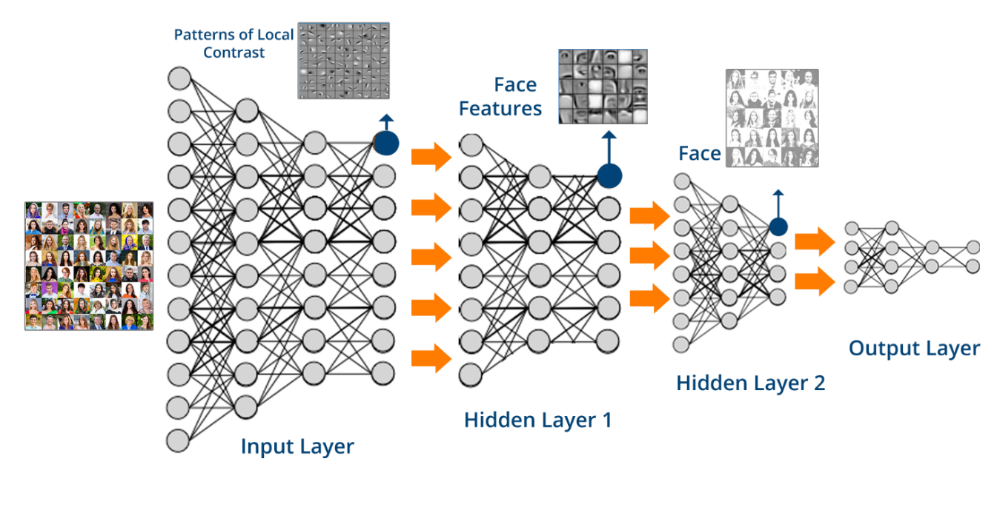


5.Requirement Analysis
Software Requirements:
Algorithms: Convolutional Neural Network (CNN) and Best Discrepancy Forest (BDF, a variant of random forest) includes following libraries in Python.
- opencv2
- numpy, pandas
- sklearn
- tensorflow
Languages: Python, Assembly Language etc.
Software: Jupyter Notebook

Slide 9

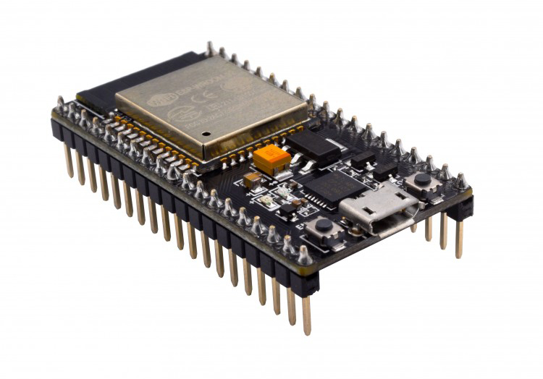
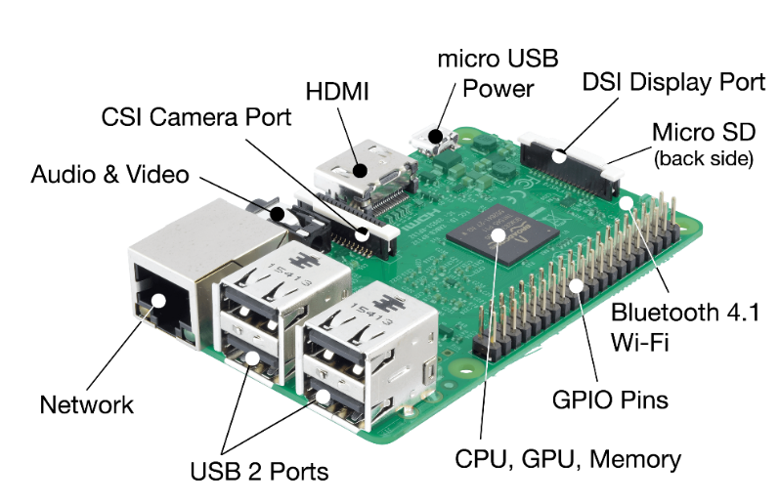




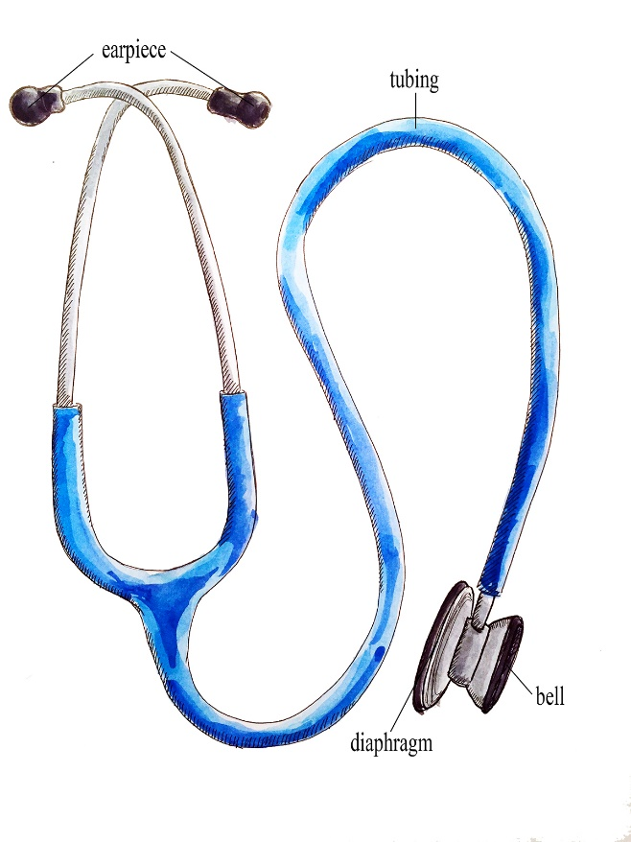
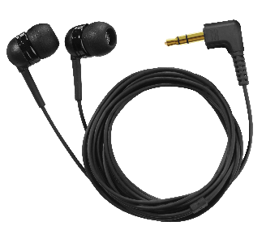
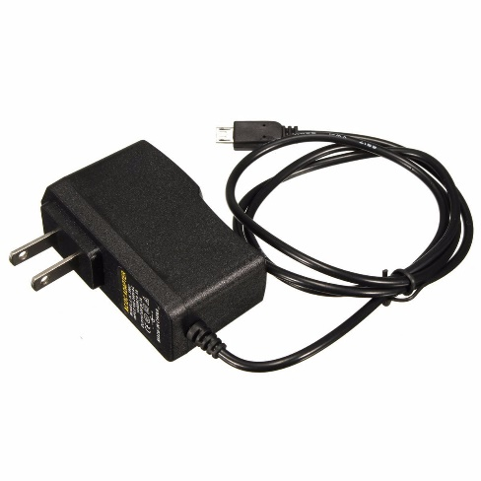
5.Requirement Analysis
Esp 32
Raspberry PI
Hardware Requirements:
Esp 32 (or Raspberry PI )
Stethoscope
Electret Microphone
Headphone (3.5mm)
Heart and Lung Sounds mode switch button
SD card needs to store Heart and Lung Sounds recoeded.wav file.
Display (0.96 inch)
USB Cable and Charger (5V DC 2.5A)
Switch button
Electret Microphone
Display
SD card
Headphone
Charger
Stethoscope

Slide 10

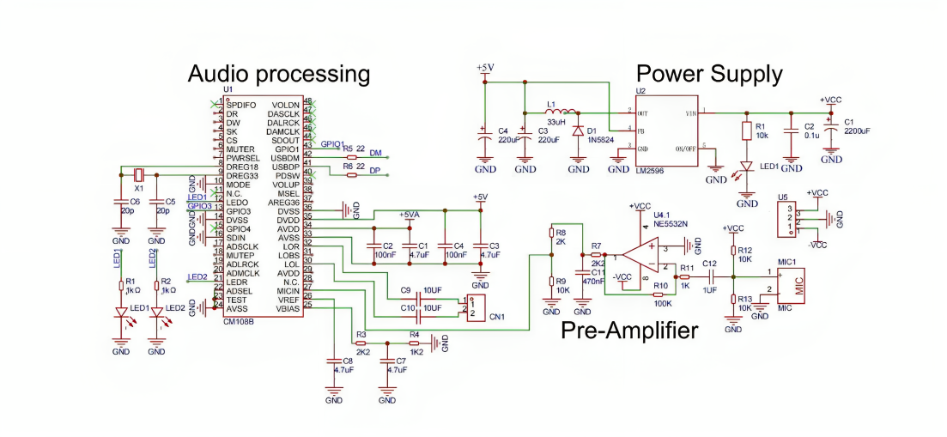
6.Proposed Model

Slide 11

7.Advantages
Early Disease Detection: By catching these conditions in their early stages, patients can receive timely medical intervention
Increased Accessibility: Making this technology affordable and widely available extends healthcare access to underserved and remote areas.
Cost-Effective: Traditional diagnostic equipment for cardiac and respiratory diseases can be expensive, making it a financial burden for patients and healthcare providers.
Reduced Healthcare Disparities: In regions with a shortage of skilled medical staff can still access reliable diagnostic tools.
Objective Diagnosis: Machine learning models can provide more accurate results compared to human.
Real-Time Monitoring: The ability to record and transmit auscultation sounds in real-time allows for continuous monitoring of patients. We can Easily identify patient health
Reduction in Diagnostic Errors: AI can assist in reducing diagnostic errors by providing a second opinion. The model can identify subtle patterns and anomalies in the auscultation sounds that might be missed by human listeners.
Data Accumulation: This continuous learning and adaptation can enhance the accuracy of disease detection over time..

Slide 12



THANK YOU

